Slide 1
Airbnb Market and Real Estate Analysis (2019–2022)
California ZIPs: 92315, 92314, 92252 and 92284.
Prepared by: Anijesudade Deborah Ifeoluwapo

Slide 2
Background
Objective:
Analyze Airbnb data to uncover insights on revenue, occupancy, pricing, and features for strategic decision-making.
Data Sources:
- Airbnb listings and calendar data
- Zillow ZIP-code level data
Time Frame:
2019 – 2022
Location:
California (ZIPs: 92315, 92314, 92252, 92284)

Slide 3
Methods & Data Processing
1. Data Preparation & Cleaning (Excel):
Converted CSV to tabular format using Text to Columns.
Removed empty columns and filled blanks with NULLs and 0s.
Applied Excel functions: PRODUCT, IF, SUMIF, AVERAGEIF, ISBLANK, ISNUMBER, COUNTIF,
VLOOKUP, SUBSTITUTE, DATE, IFERROR, TRIM, LEFT, MID, PROPER, FIND and so on.
Converted date strings to real Excel date formats.
2. Derived Columns & Logic:
Filled missing Nightly Rate using: Revenue / Openness.
Added a new column: Nights booked = Occupancy x Openness
Created 'Occupancy Status' column:
1 = Fully Booked
0 = Not/Partially Booked (some occupancy = 0 still had revenue).

Slide 4
Methods & Data Processing
3. Data Summarization & Visualization (Excel):
Built Pivot Tables and Charts for Revenue, Occupancy, Amenities, Seasonal and Regional trends.
4. Dashboard Development (Power BI):
Loaded cleaned dataset for into Power BI for further cleaning and visualizations.
Built interactive dashboards: Revenue Trends, Occupancy, ZIP Comparisons, Amenities Impact.

Slide 5
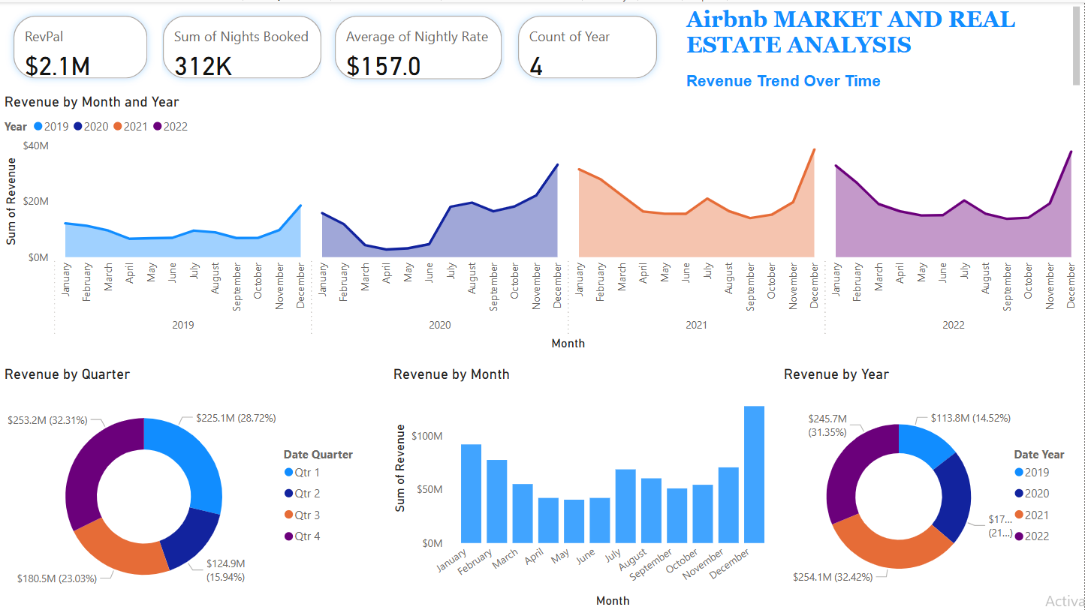
Revenue Trend Over Time (2019–2022)

Slide 6
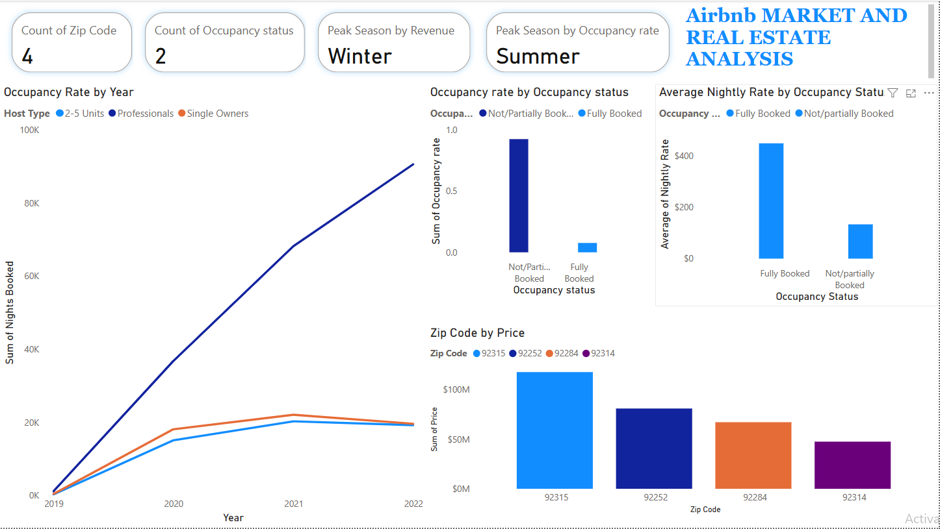

Slide 7
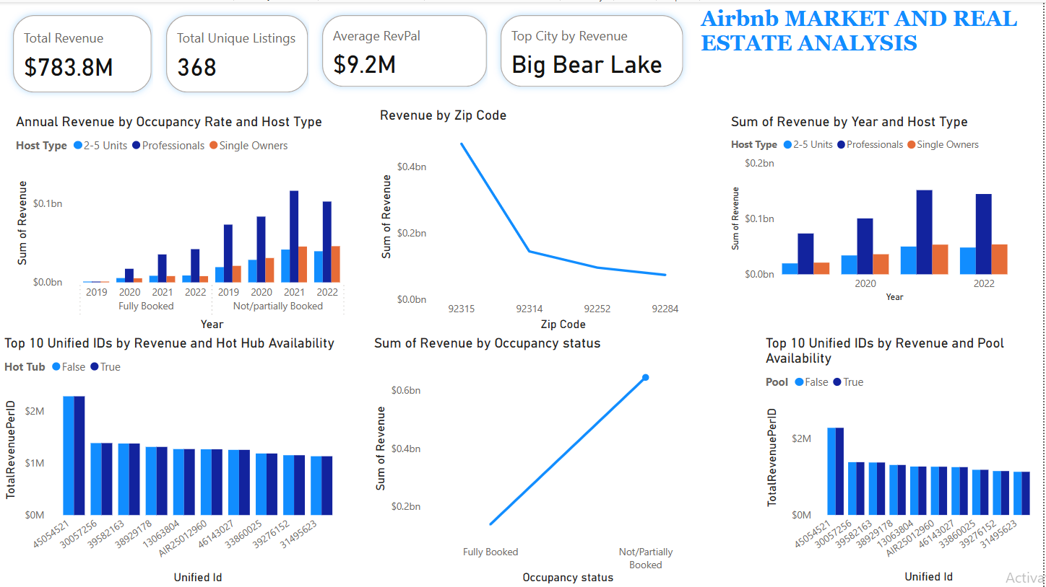

Slide 8
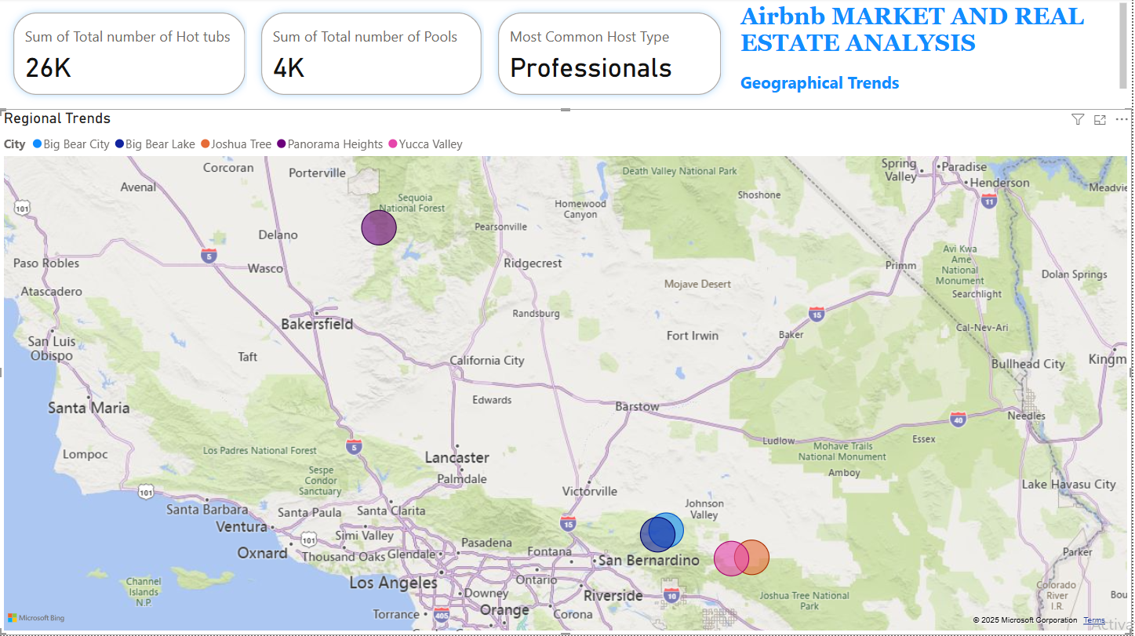
Geographical Trends

Slide 9
Key Insights
December consistently yielded the highest revenue across years.
ZIP code 92315 (Big Bear Lake) had both the highest revenue and nightly rate.
The top Host Type by revenue and occupancy rate is “Professionals”.
Year 2021 generated the highest revenue.
Fully booked listings are associated with higher revenue and rates.
Listings with hot tubs and pools earn significantly more.
Listings with hot tubs generated have the highest occupancy and revenue.
Quarter 4 generates the highest overall revenue.
Hot tub is the most common amenity.
The sum of all the revenue generated from “Not/Partially Booked” is higher than the “Fully Booked”. This is because 92% of the occupancy status are “Not/partially Booked” while fully booked is only 8%.

Slide 10
Actionable Recommendations
Target high-performing ZIPs like 92315 and 92314 for investment.
Prioritize listings with hot tubs and pools.
Use dynamic pricing models to maximize seasonal peaks.
Focus on improving occupancy in low months (May–June).
Encourage minimum amenity upgrades to increase desirability.

Slide 11
Thank You!!!
Prepared by: Anijesudade Deborah Ifeoluwapo
Contact: anijesudadeola1@gmail.com
09033481138.

